Slide 1
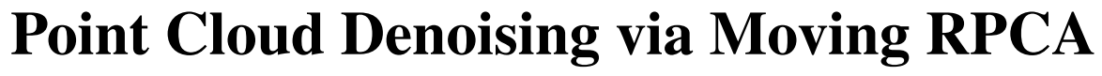
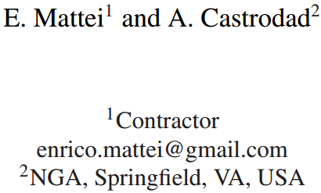
Computer Graphics Forum (CGF),2016.
Reporter：Ge Linlin
Date：2019.03.19

Slide 2
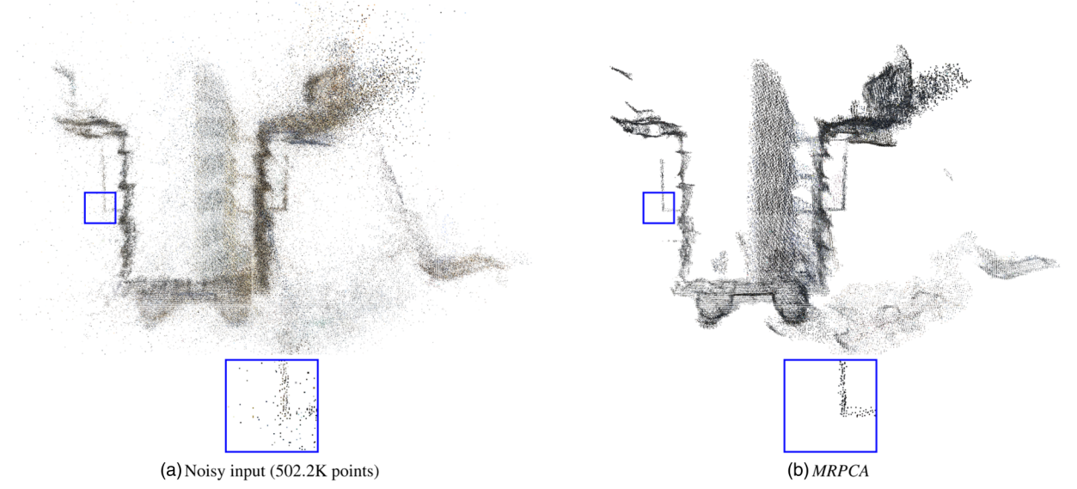
1. Introduction
Algorithm: MRPCA with the full name Moving Robust Principal Component Analysis.
Issues: Points’ Normal Estimation, Outlier Removal, Sharp Feature Preservation.

Slide 3
1. Introduction
Contributions:
A model which dose not require oriented normals is proposed, it has the following properties:
It’s robust vis-à-vis outliers;
It does not require oriented normal as part of input;
Advantages:
Robust, Easy to implement and parallelize.

Slide 4
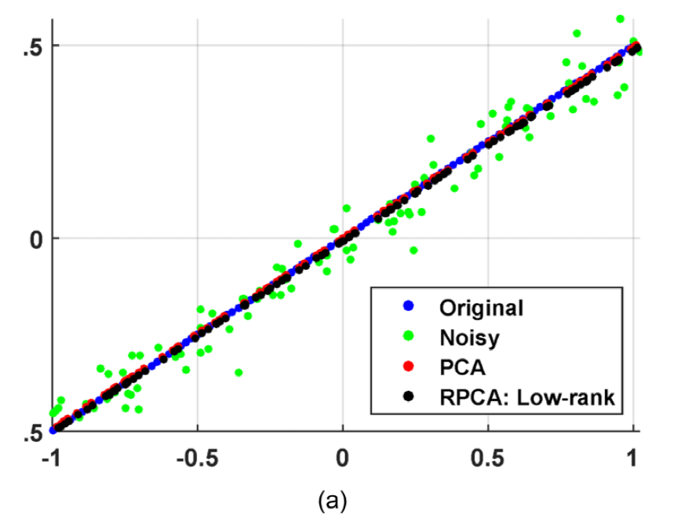
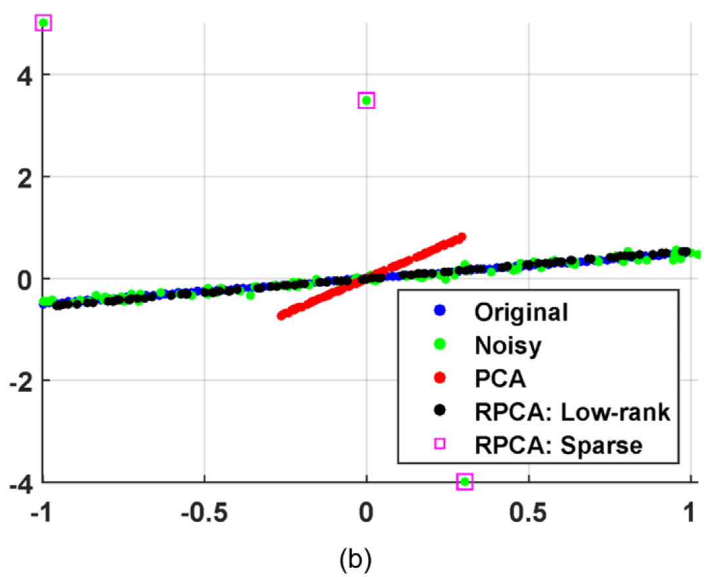
2. RPCA ( Robust Principal Component Analysis)
Why this paper is based on RPCA rather than PCA?
Compared to PCA, RPCA is more robust when facing outlier.
Without Outlier
With Three Outlier

Slide 5
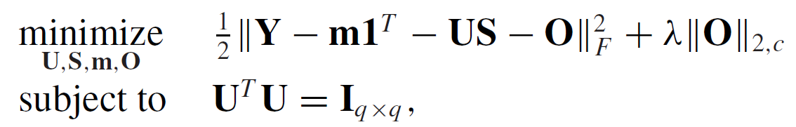
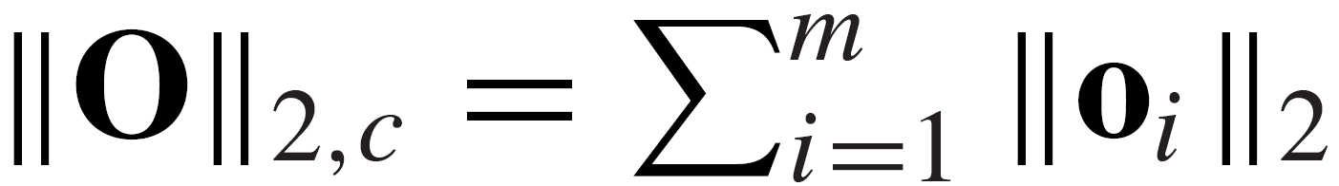
2. RPCA
Assumption:
Suppose that it is a linear problem.
Outlier-aware Factor Analysis Model:
Objective Function:
Applications:
Outlier-sparsity Control
Online Robust Subspace Estimation
Robust Spectral Clustering
$$x_{i}=y_{i}+o_{i}=m+Us_{i}+e_{i}+o_{i} i=1,⋯,N$$
Where,

Slide 6
3 MRPCA (Moving Robust Principal Component Analysis)
MRPCA is an algorithm which applied RPCA to point cloud denoising.
(1) A factor analysis model to process local neighborhoods;
(2) A global approach to process overlapped regions.

Slide 7
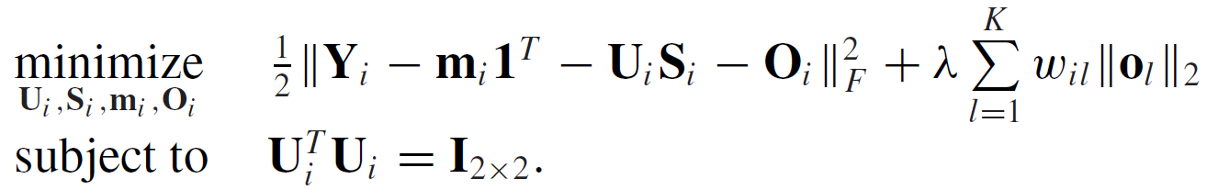
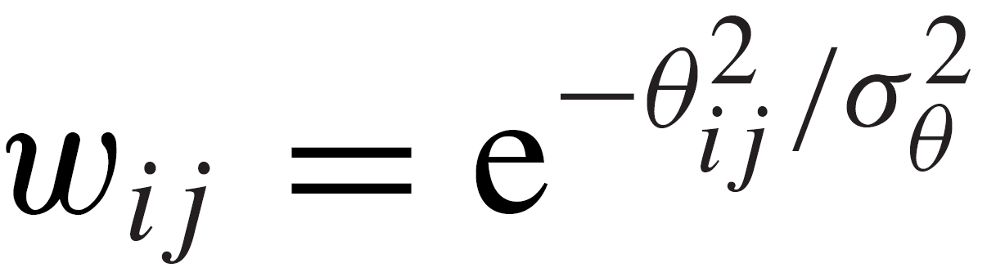
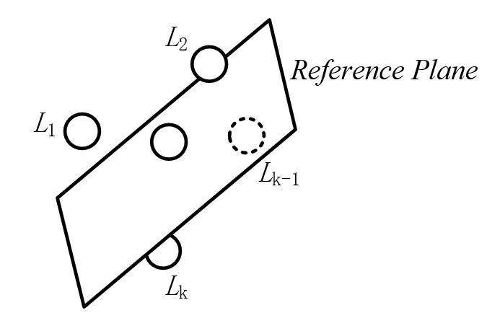
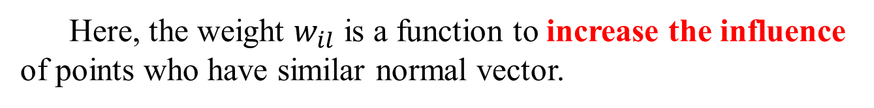
3.1 MRPCA —— Local Neighborhoods Processing
Here, the weight $w_{il}$ is a function to increase the influence of points who have similar normal vector.
Gaussian Kernel Function
or
Radial Basis Function
Angle between
Two Points’ Normals

Slide 8
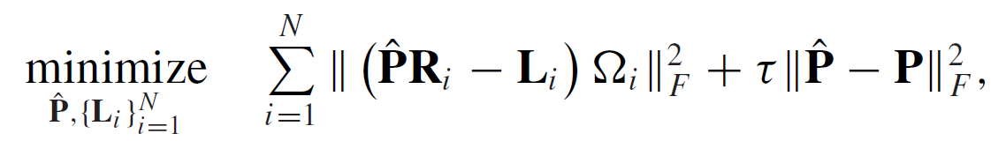
3.2 MRPCA —— Overlapped Regions Processing
Local Data Error
Data Error

Slide 9
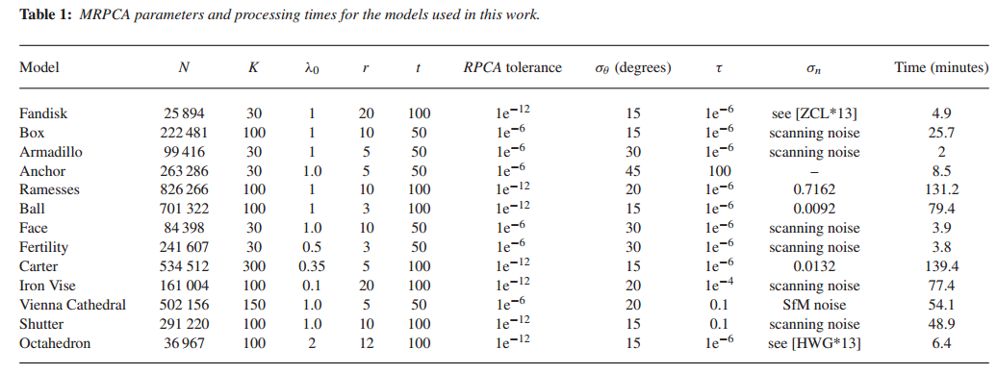
3.3 MRPCA —— Parameters and Processing Time
The maximum iteration times of RPCA solver
The maximum iteration times of MRPCA

Slide 10
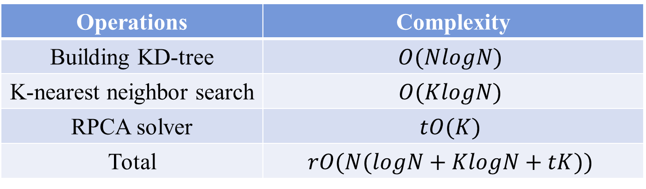
3.4 MRPCA —— Computational Complexity
Operations | Complexity
Building KD-tree | $$O(NlogN)$$
K-nearest neighbor search | $$O(KlogN)$$
RPCA solver | $$tO(K)$$
Total | $$rO(N(logN+KlogN+tK))$$
The maximum iteration times of MRPCA
The size of neighbourhoods
The maximum iteration times of RPCA solver

Slide 11
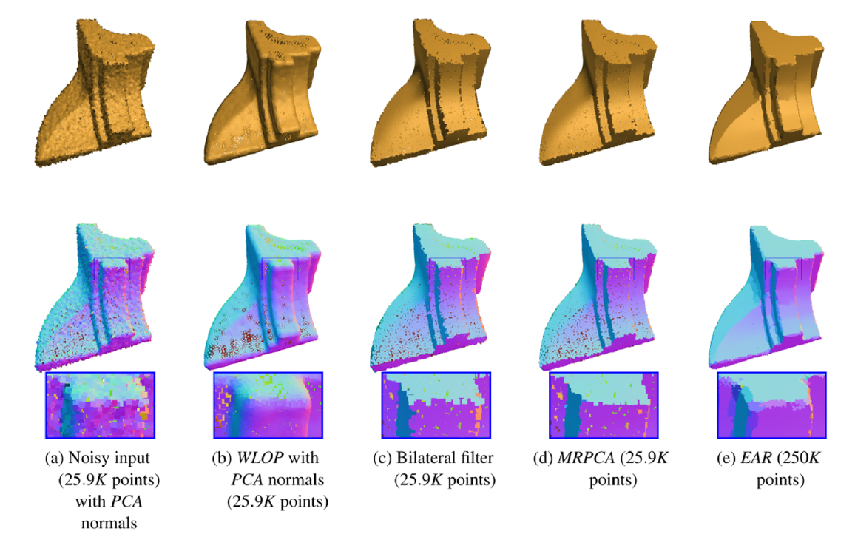
4. Results —— Handling Sharp Features

Slide 12
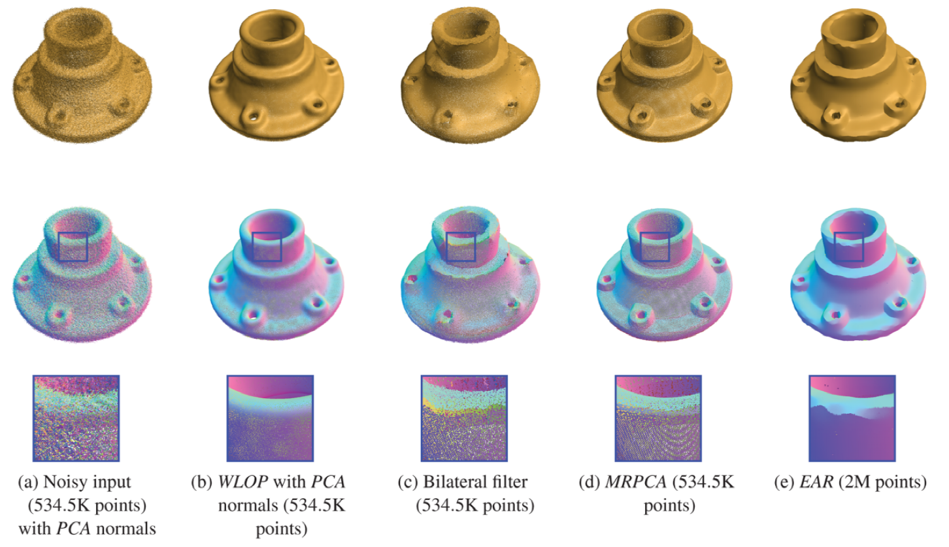
4. Results —— Handling SFM Model

Slide 13
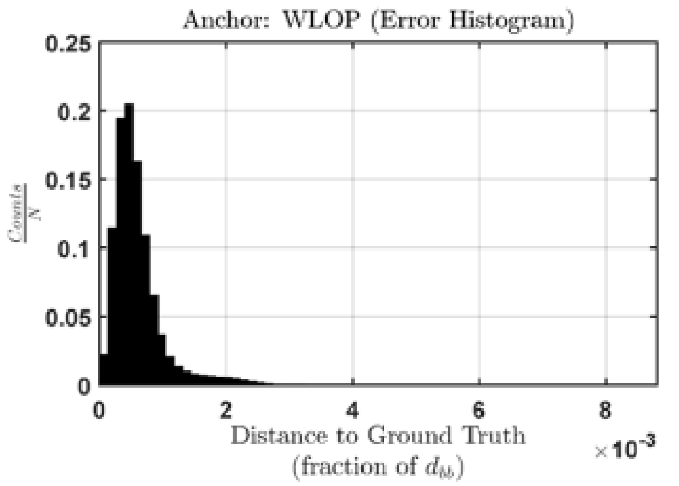
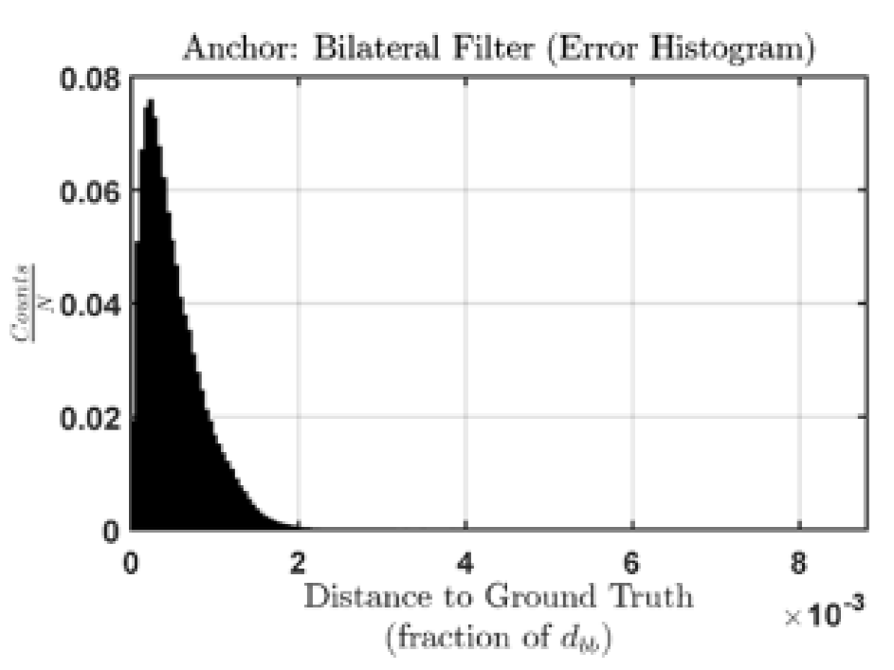
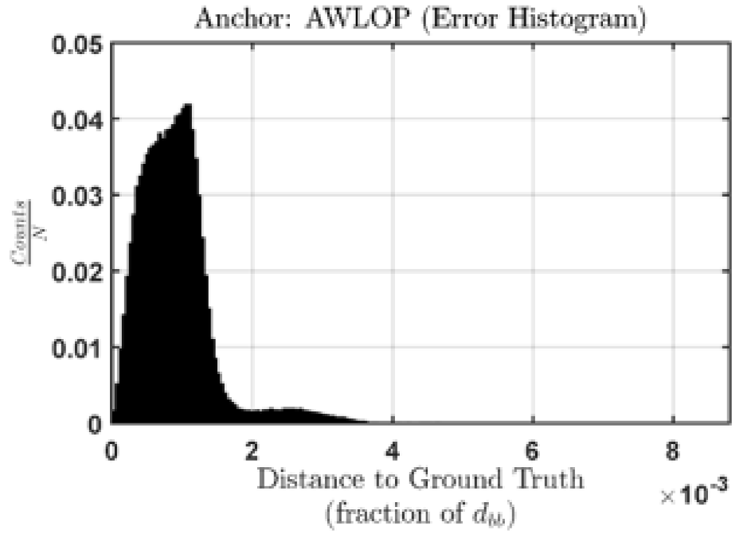
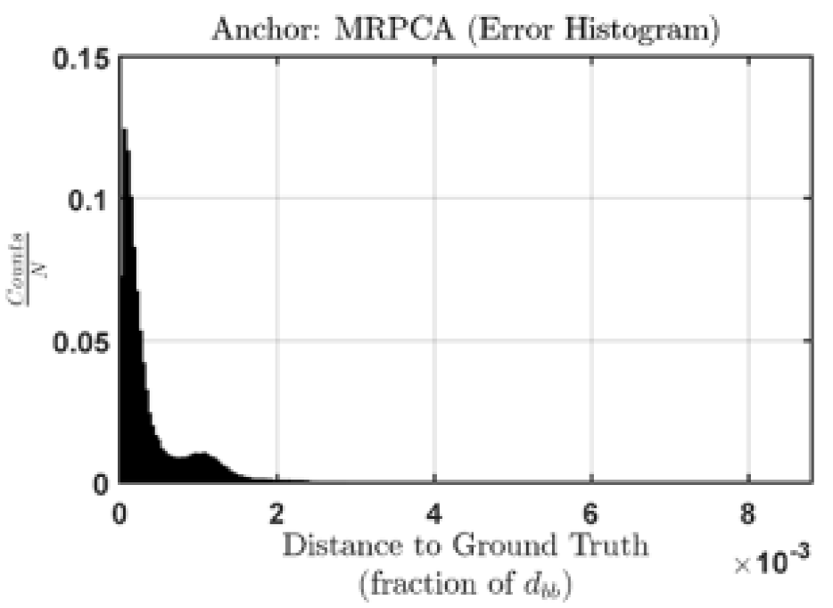
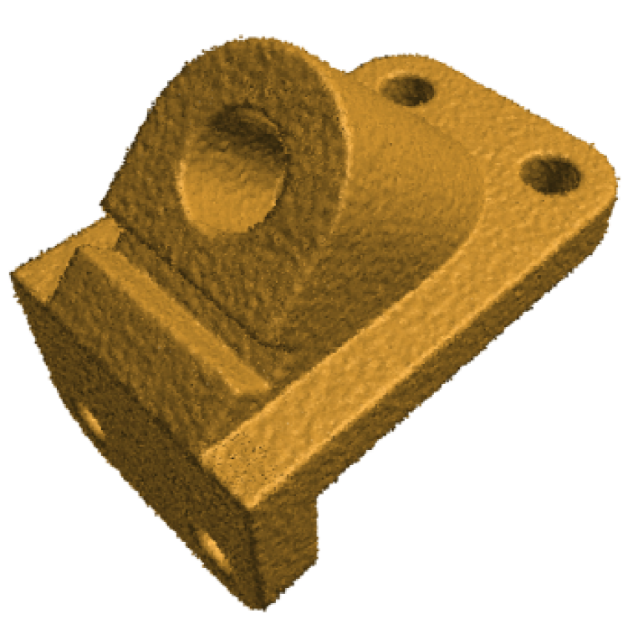
4. Results ——Error Analysis

Slide 14
5. Limitations
When facing sharp features and high noise levels, computation of MRPCA will considerably increase due to a larger neighbourhood.
Normals estimated by RPCA are not stable.

Slide 15
5. Conclusion
MRPCA is effective in denoising point cloud with and without sharp feature;
MRPCA is outperform well-known approaches such as the bilateral filter, WLOP and AWLOP;
L1-norm worked better than Frobenius norm, but Frobenius norm is used in this article to decrease computation;
The neighbourhood size is obtained from a function which is relevant to local point density.

Slide 16
Thanks!

